Slide 1
Parallel Processing
Presented by:
Dr. Ashish Kumar Maurya

Slide 2
Contents
Concurrency vs. Parallelism
Parallel Computing Platforms
Different Processor Architectures
Computing Performance
Multi-core Programming
Challenges in Multi-core Programming

Slide 3
Concurrency vs. Parallelism
Concurrency
Two events/threads are said to be concurrent if they occur within the same time interval
When multiple software threads of execution are running concurrently, the execution of the threads is interleaved onto a single hardware resource
The active threads are ready to execute, but only one thread may make progress at a given point in time

Slide 4
Concurrency vs. Parallelism
Parallelism
When multiple software threads of execution are running in parallel, it means that the active threads are running simultaneously on different hardware resources, or processing elements
Multiple threads may make progress simultaneously

Slide 5
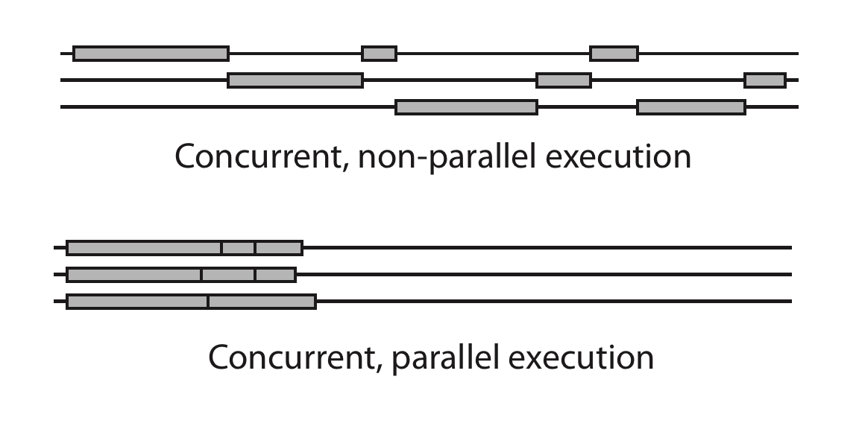
Concurrency vs. Parallelism
Example

Slide 6
Parallel Computing Platforms
Hardware also must supports the simultaneous execution of multiple threads.
Computer architectures can be classified by two different dimensions:
Instruction streams
Data Streams

Slide 7
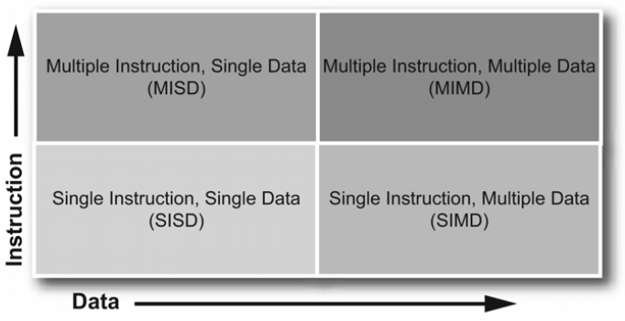
Parallel Computing Platforms
Flynn’s taxonomy

Slide 8
Parallel Computing Platforms
Flynn’s taxonomy
SISD
Provides no parallelism in hardware
MISD
Generally used more as a theoretical model than a practical
SIMD
Useful in applications such as general digital signal processing, image processing and multimedia applications
MIMD
Most common parallel computing platform today eg. Intel Core Duo processor

Slide 9

SISD

Slide 10
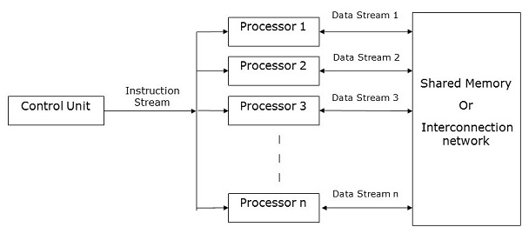
SIMD

Slide 11
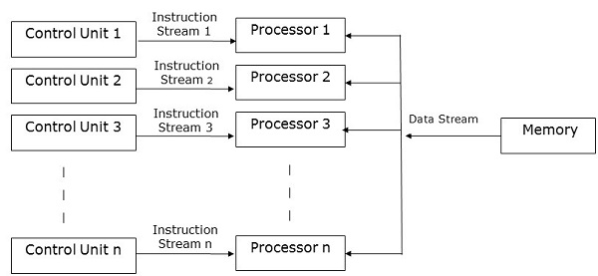
MISD

Slide 12
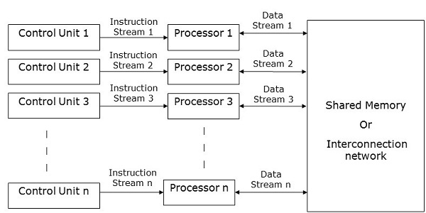
MIMD

Slide 13
Different Processor Architectures
Moore’s Law
Single-core
Multi-processor
Simultaneous Multi-Threading or SMT
Multi-core

Slide 14
Different Processor Architectures
Moore’s Law
Observation, not a physical or natural law
Guiding principles of computer architecture
“Transistor density doubles every 18 months”
Gordon E. Moore is co-founder of Intel
Exponential growth
PC costs decline
PCs are building bricks of all future systems

Slide 15
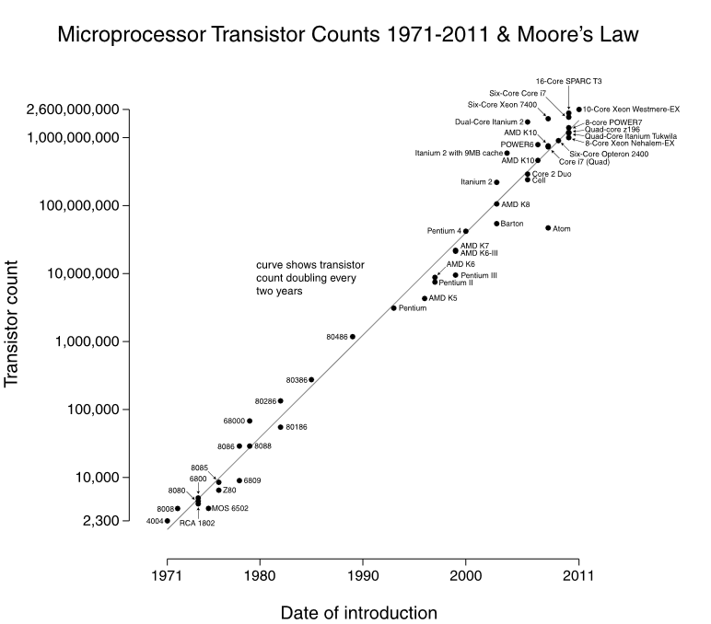
Different Processor Architectures

Slide 16
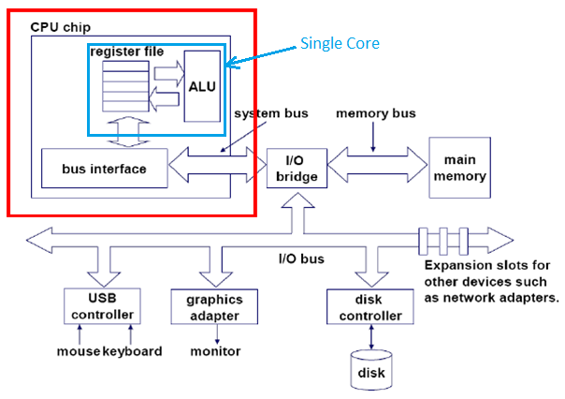
Different Processor Architectures
Single core
Has only one core or CPU in which one instruction executed at a time

Slide 17
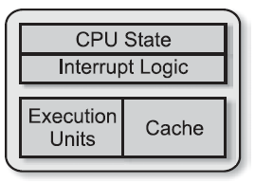
Different Processor Architectures
Single core

Slide 18
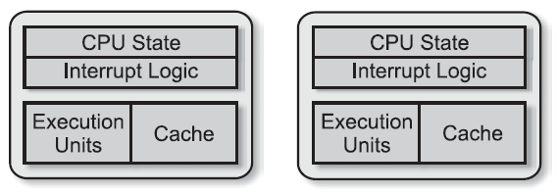
Different Processor Architectures
Multi-processor
Having two or more processing units
Allow true parallel execution
The tradeoff made in this case is increasing the overall system cost

Slide 19
Different Processor Architectures
Multi-processor
Types on the basis of processor coupling:
Tightly coupled multi-processor
Loosely coupled multi-processor

Slide 20
Different Processor Architectures
Simultaneous Multi-Threading or SMT
A physical processor is made up of a number of different resources
including the architecture state—the general purpose CPU registers and interrupt controller registers
caches, buses, execution units, and branch prediction logic.
To define a thread, only the architecture state is required.
A logical processor can thus be created by duplicating the architecture space.

Slide 21
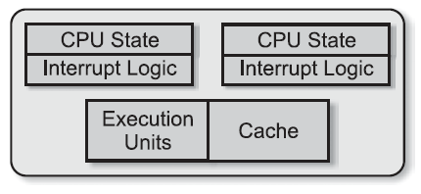
Different Processor Architectures
Simultaneous Multi-Threading or SMT
SMT is a technique in which the execution resources are shared among the different logical processors.
Issue multiple instructions from multiple threads in one cycle.

Slide 22
Different Processor Architectures
Simultaneous Multi-Threading or SMT
Intel’s implementation of SMT is known as Hyper-Threading Technology or HT Technology
HT Technology literally interleaves the instructions in the execution pipeline
HT Technology achieves performance gains through latency hiding

Slide 23
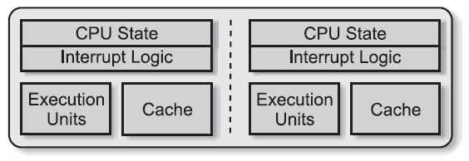
Different Processor Architectures
Multi-core
Next logical step from SMT
Uses Chip Multiprocessing (CMP)
Integrates two or more processors into one chip, each executing threads independently

Slide 24
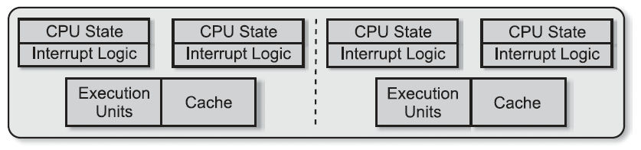
Different Processor Architectures
Multi-core with HT Technology
Effectively increasing the number of logical processors by twice the number of execution cores

Slide 25
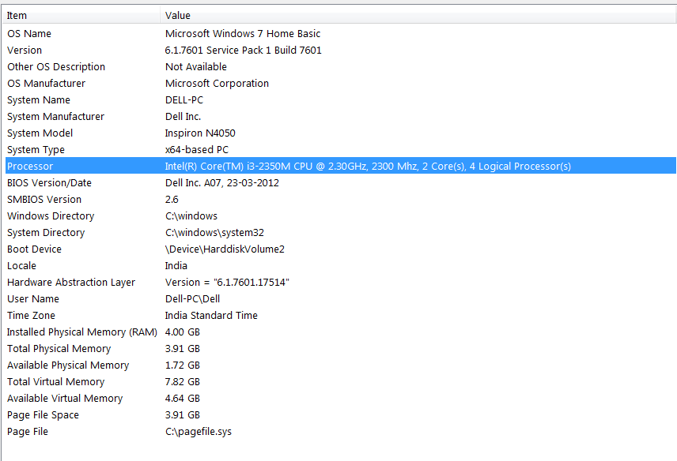
Different Processor Architectures
Multi-core with HT Technology

Slide 26
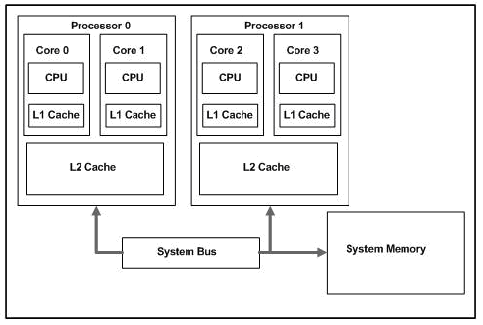
Different Processor Architectures
Dual-core example

Slide 27


Computing Performance
Speedup
Amdhal’s Law
S is the time spent executing the serial portion of the parallelized version
N is the number of processor cores
Notes:
decreasing the serialized portion by increasing the parallelized portion is of greater importance than adding more processor cores.

